Slide 1

ANOMALY DETECTION IN HYPOTHYROIDISM DATASET
Unsupervised Learning
Andrea Palmieri - 921785 - a.palmieri13@campus.unimib.it
Andrea Yachaya - 913721 - a.yachaya@campus.unimib.it

Slide 2

AGENDA
Dataset, preprocessing and metrics
Hierarchical Clustering
Average and Complete Linkage
K-Means and K-Medoids
K-Prototypes
DBSCAN
Local Outlier Factor
Adjusted Rand Index
Results

Slide 3
INTRODUCTION
Focus of Study:
Application of the following unsupervised learning methods for anomaly detection on unlabelled hypothyroidism dataset.
Distance-Based clustering
Density-Based clustering
Dataset Overview:
7,200 observations
Mixed data types:
15 binary
6 continuous features.
No labeled data available.

Slide 4
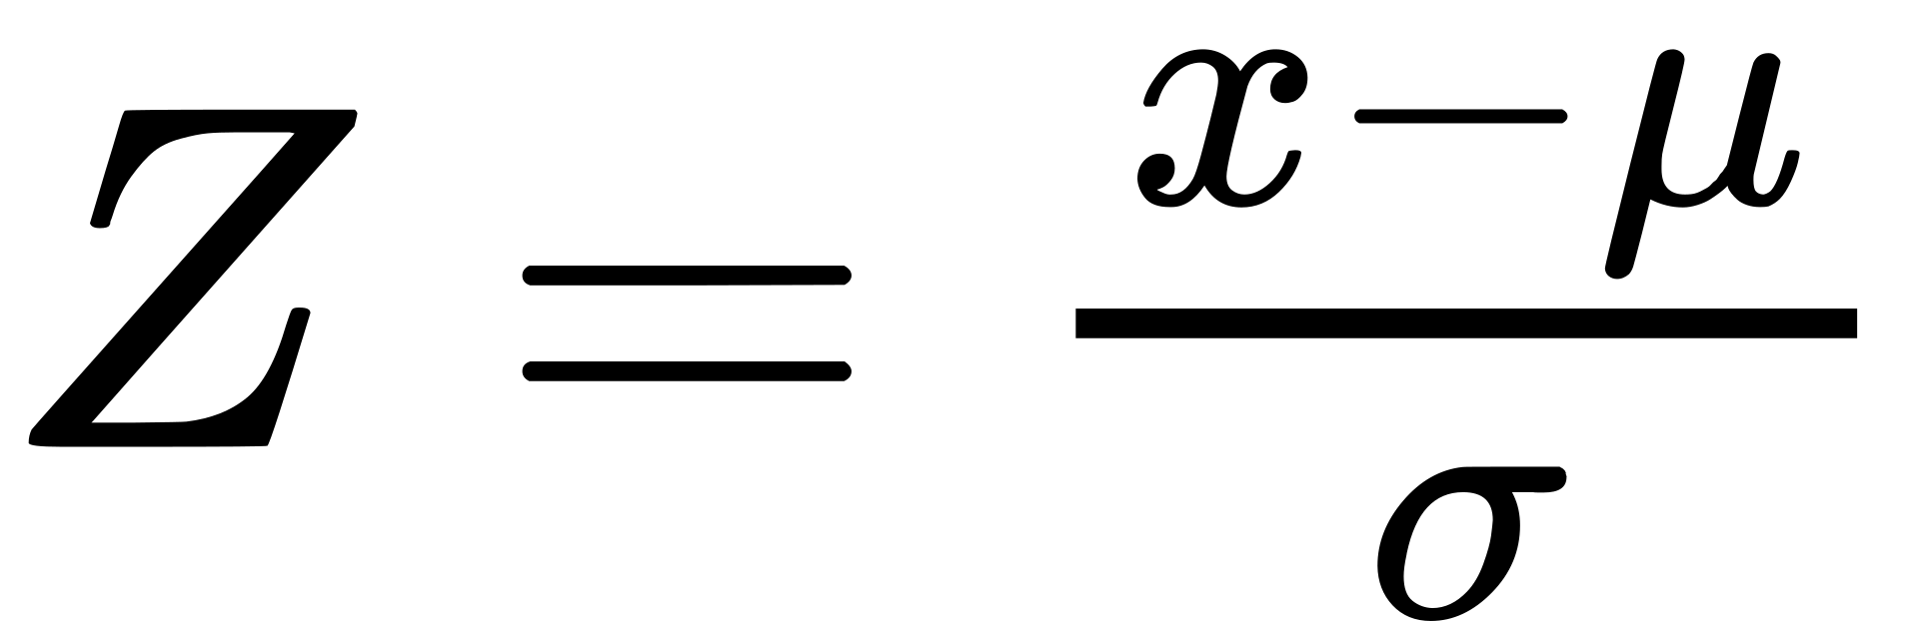
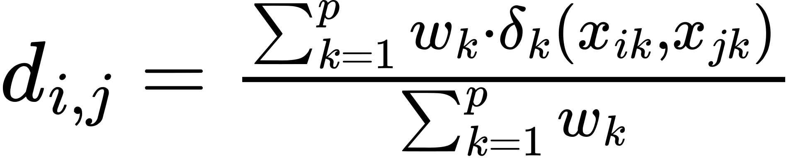
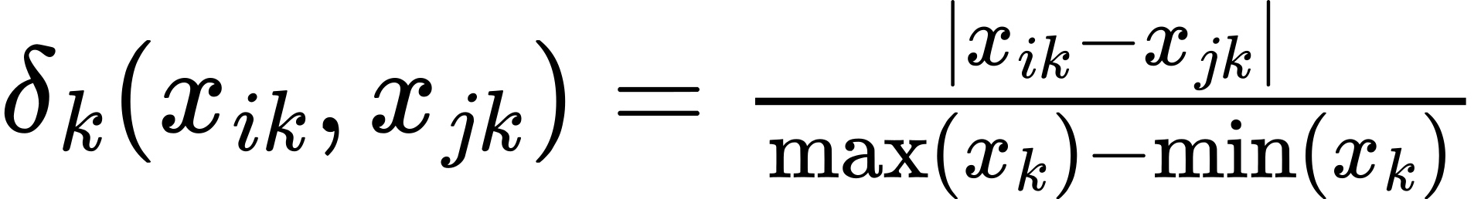
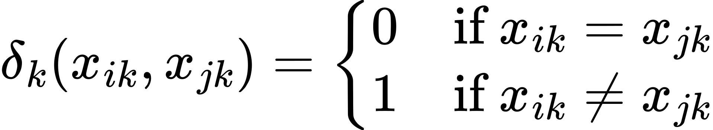
DATASET PREPROCESSING
GOWER DISTANCE
Continuous Features Standardization:
To prevent any single feature from disproportionately influencing the results, they were scaled using Z-Score
Binary Features Handling:
As these features already indicated the presence or absence of a feature, no one-hot encoding was necessary
Euclidean distance not suitable due to mixed data types nature of dataset
Therefore Gower Distance was used
Numerical Features
Categorical Features
All weights equal = 1 due to missing specific domain knowledge

Slide 5
DIMENSIONALITY REDUCTION
Principal Component Analysis (PCA):
PCA transforms data into a set of orthogonal uncorrelated components, ordered by the amount of variance they explain in the data.
PCA is not suitable for mixed data types.
Excluded from this study.
Factor Analysis of Mixed Data (FAMD):
FAMD is specifically designed to handle mixed data types datasets
FAMD was used only for visualization
It’s not suited for anomaly detection due to the difficulty in reconstructing the original features from the FAMD coordinates

Slide 6
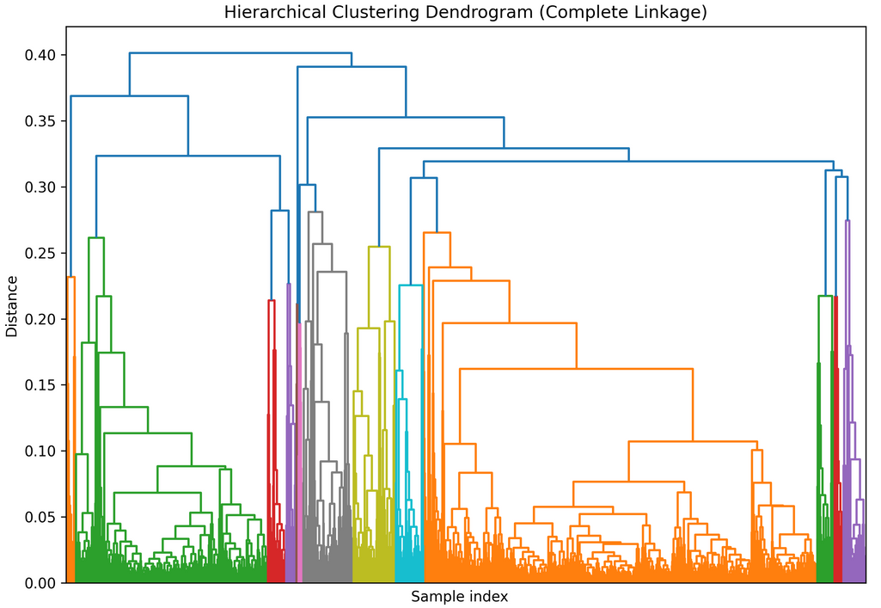
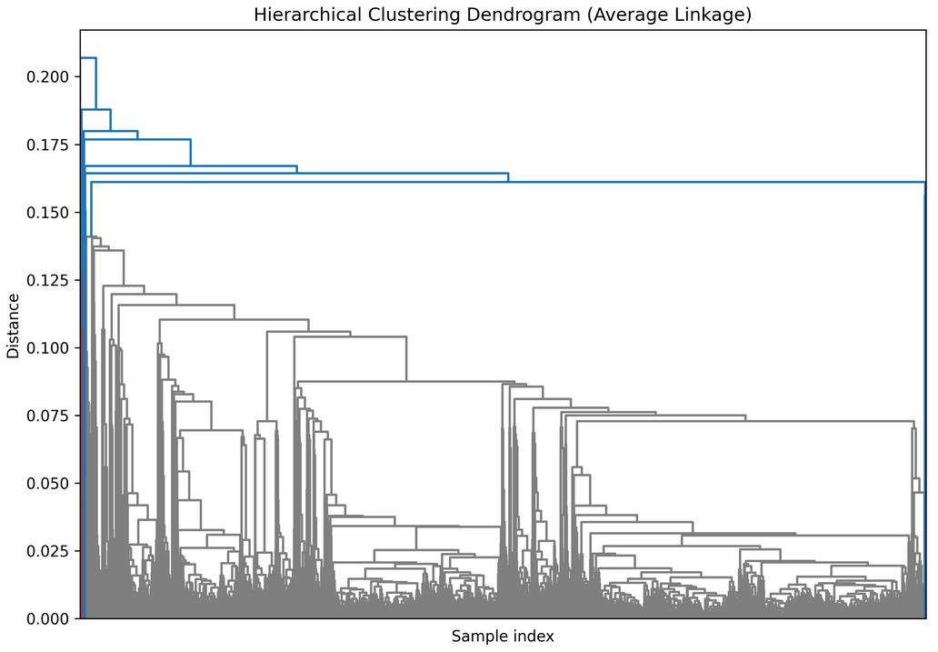
HIERARCHICAL CLUSTERING: DENDROGRAMS
Hierarchical clustering produces nested clusters, visualized as a dendrogram. There are several methods to compute inter-cluster proximity: single, complete, average, centroids-based and Ward’s.
We opted for complete and average linkage for their compatibility with mixed data types datasets.
COMPLETE LINKAGE
AVERAGE LINKAGE
Highly branched structure with many small and tight clusters.
A more balanced hierarchical structure with fewer branches and larger clusters, and a gradual increase in distance between clusters as they merge.

Slide 7
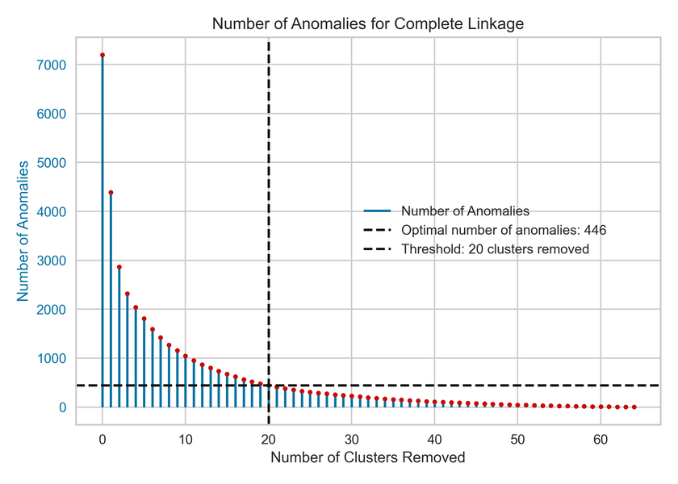
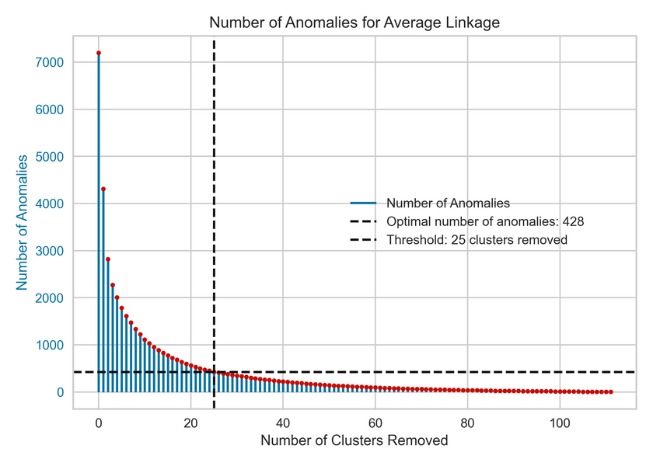
HIERARCHICAL CLUSTERING: DETECTING ANOMALIES
The optimal distance metric was the one with the highest Silhouette score.
Clusters were ranked by size, and larger clusters were excluded to identify anomalies. The exclusion threshold was set where anomaly numbers stopped changing significantly.
COMPLETE LINKAGE
AVERAGE LINKAGE
Optimal distance: 0.147, Silhouette score: 0.519.
At 20 clusters removed, 446 anomalies found.
Optimal distance: 0.065, Silhouette score: 0.649.
At 25 clusters removed, 428 anomalies found.

Slide 8
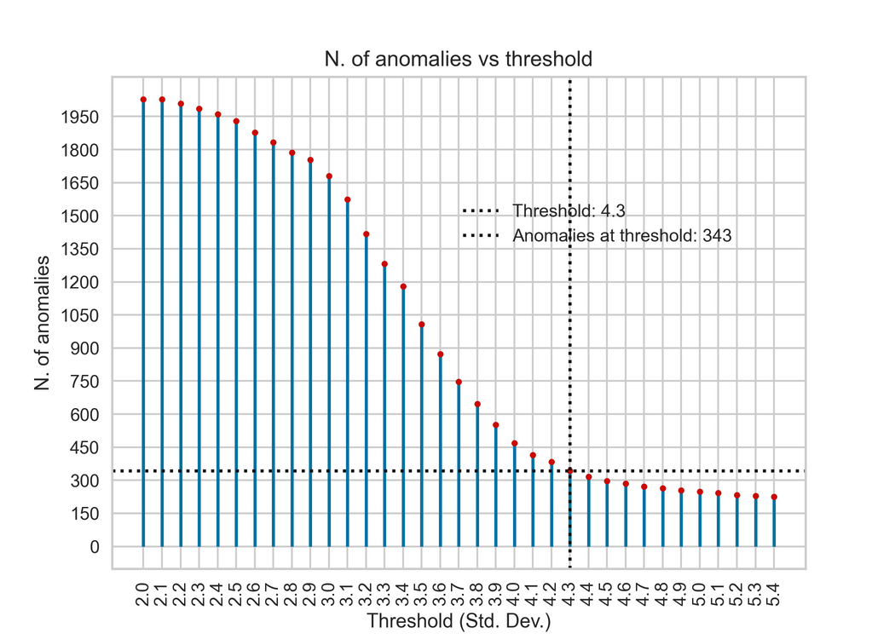
K-MEANS AND K-MEDOIDS
K-Means was not used due to the Euclidean distance incompatibility with mixed data types datasets.
K-Medoids
can use the precomputed Gower Distance matrix
suitable for our dataset
uses medoids - actual data points - as centers of the clusters.
Optimal number of clusters
determined using the elbow method: 5 clusters.
Anomalies were identified by elements deviating more than a specified number of standard deviations from the mean distance to their nearest medoid.
343 anomalies found with a threshold of 4.3 standard deviations from the mean.

Slide 9
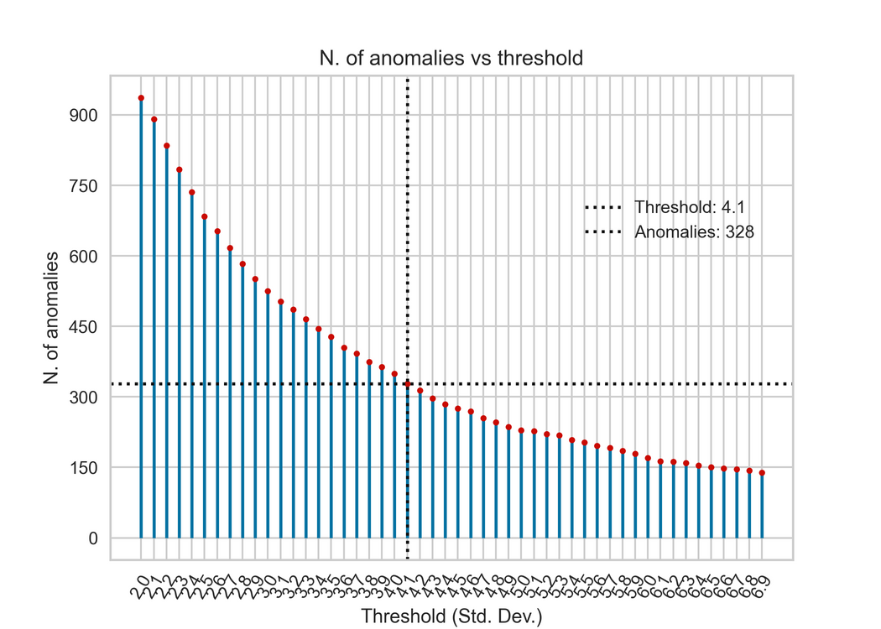
K-PROTOTYPES
Uses prototypes - synthetic points - as centers of the clusters, computed as:
for numerical attributes: the mean of the cluster
for categorical attributes: the mode of the cluster
Optimal number of clusters
determined using the elbow method: 4 clusters.
Anomalies identified by elements deviating more than a specified threshold from their prototype
328 anomalies found with a threshold of 4.1 standard deviations from the mean

Slide 10
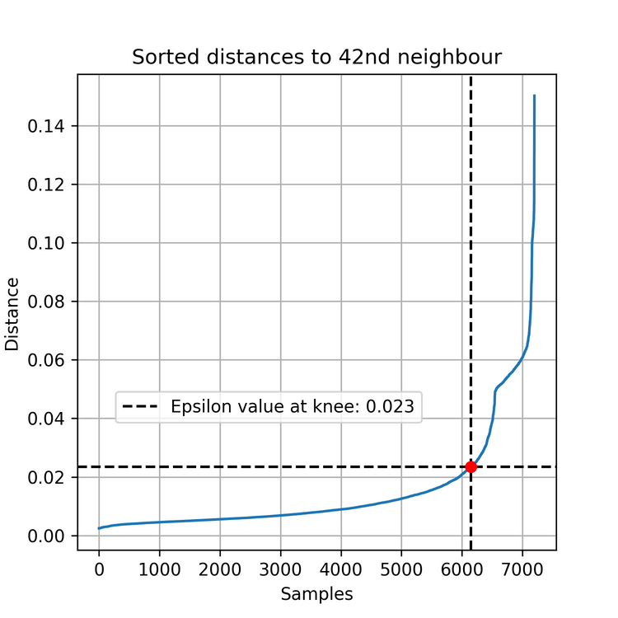
DBSCAN
Density-based method that groups data points based on the number of neighbours in a radius.
In requires two key parameters:
ε (epsilon): radius around a point to search for neighbors
A starting value was determined by computing the distance from the farthest 42nd data point, then by considering the knee of the resulting curve
MinPts: minimum number of points within ε-radius to define a core point
Determined heuristically as twice the number of features*
MinPts = 42
We used the precomputed Gower Distance matrix.
* [Sander et al. 1998] J¨org Sander, Martin Ester, HansPeter Kriegel, and Xiaowei Xu. Density-Based Clustering in Spatial Databases: The Algorithm GDBSCAN and Its Applications. Data Mining and Knowledge Discovery, 2:169–194, 1998.

Slide 11
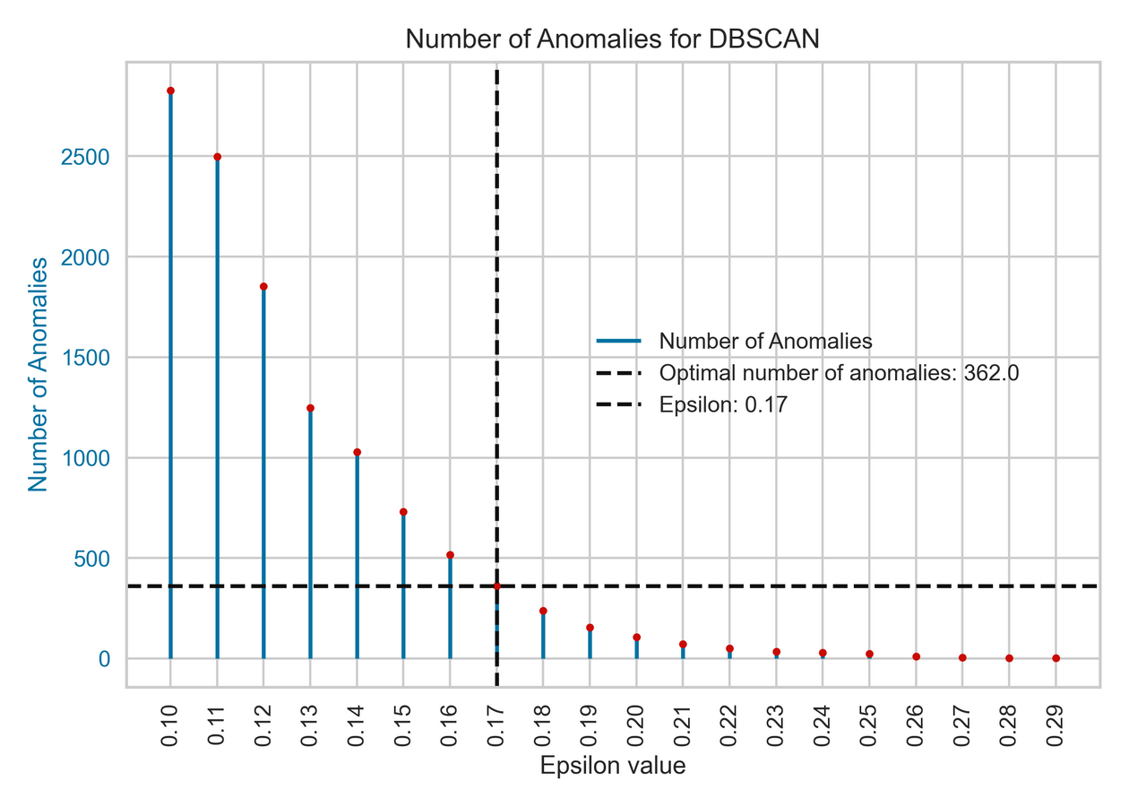
DBSCAN
Anomalies were identified as directly proportional to the average distance to neighbouring points and inversely proportional to the density (number of points in the ε-radius).
The optimal Epsilon was chosen visually as the point where anomaly numbers stopped changing significantly.
Sparser points will be considered as more anomalous.
362 anomalies found with a Epsilon of 0.17

Slide 12
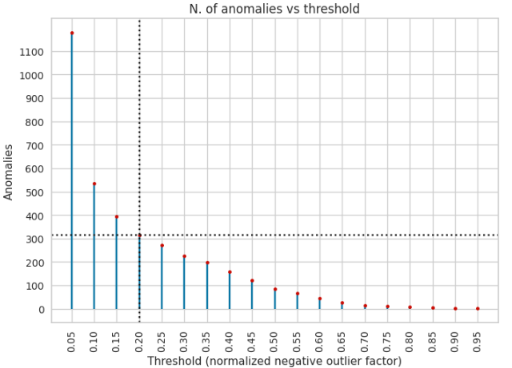
LOCAL OUTLIER FACTOR (LOF)
Computed using the precomputed Gower Distance matrix.
For each data point, LOF returns its negative outlier factor of being anomalous, then normalized to [0 - 1]
The threshold was chosen visually
316 anomalies found with a threshold of 0.20

Slide 13
ADJUSTED RAND INDEX
To evaluate the differences in the results returned by different anomalies detection techniques, we employed the use of the Adjusted Rand Index (ARI), which is a measure used to evaluate the similarity between two data clusterings, accounting for the possibility of random agreement.
ARI | HC Average | HC Complete | DBSCAN | K-Medoids | K-Prototypes | LOF
HC Average | 1 | 0.70 | 0.74 | 0.54 | 0.05 | 0.67
HC Complete | 0.70 | 1 | 0.54 | 0.41 | 0.04 | 0.58
DBSCAN | 0.74 | 0.54 | 1 | 0.57 | 0.07 | 0.47
K-Medoids | 0.54 | 0.41 | 0.57 | 1 | 0.12 | 0.32
K-Prototypes | 0.03 | 0.01 | 0.04 | 0.09 | 1 | 0.30
LOF | 0.67 | 0.58 | 0.47 | 0.32 | 0.05 | 1

Slide 14
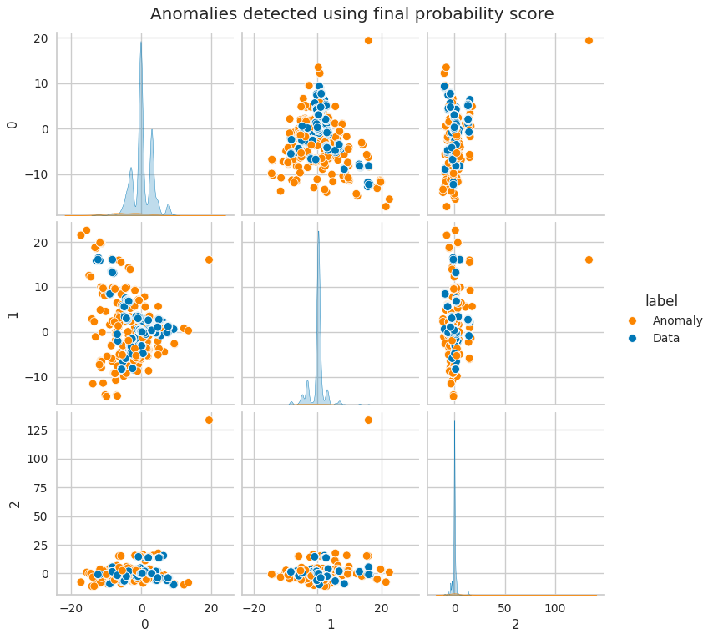
COMPUTING THE FINAL PROBABILITIES
The final probabilities are the mean probability of
HC Average
HC Complete
DBSCAN
probabilities.
A total of 402 anomalies were found.
ARI | HC Average | HC Complete | DBSCAN
HC Average | 1 | 0.70 | 0.74
HC Complete | 0.70 | 1 | 0.54
DBSCAN | 0.74 | 0.54 | 1

Slide 15
Thank you.
Andrea Palmieri - 921785 - a.palmieri13@campus.unimib.it
Andrea Yachaya - 913721 - a.yachaya@campus.unimib.it

